Slide 1
Applying Testing Techniques to Hadoop Development
Mark Johnson
markfjohnson@gmail.com

Slide 2
Who Am I?
Mark Johnson
Regional Director Services - Hortonworks
Too many years of programming experience
Created lots of bugs in my career…but hate for them to be found by others

Slide 3

Who are You?
Technologist
Programmer
Want to produce low defect or defect free code in Hadoop

Slide 4
Good Hadoop Development is Hard!

Slide 5

Lots of Data !

Slide 6
Volume
Velocity
Variety

Slide 7
Fast Release Pressure!

Slide 8
BUGS!

Slide 9
Will anyone really notice that little problem which affects only 1% of the rows?

Slide 10
YES!
1% of the financial transactions on Wall Street is a lot of money!
Big Data can amplify small problems!

Slide 11

Problem #1: Speed of Light
Notes:
Example:23 mb/sec
File Size: 500mb -> 22 seconds
File Size: 1,000 -> 43 seconds

Slide 12

Problem #2: Data Permutations
Notes:
More data often means more possible data permutations.

Slide 13
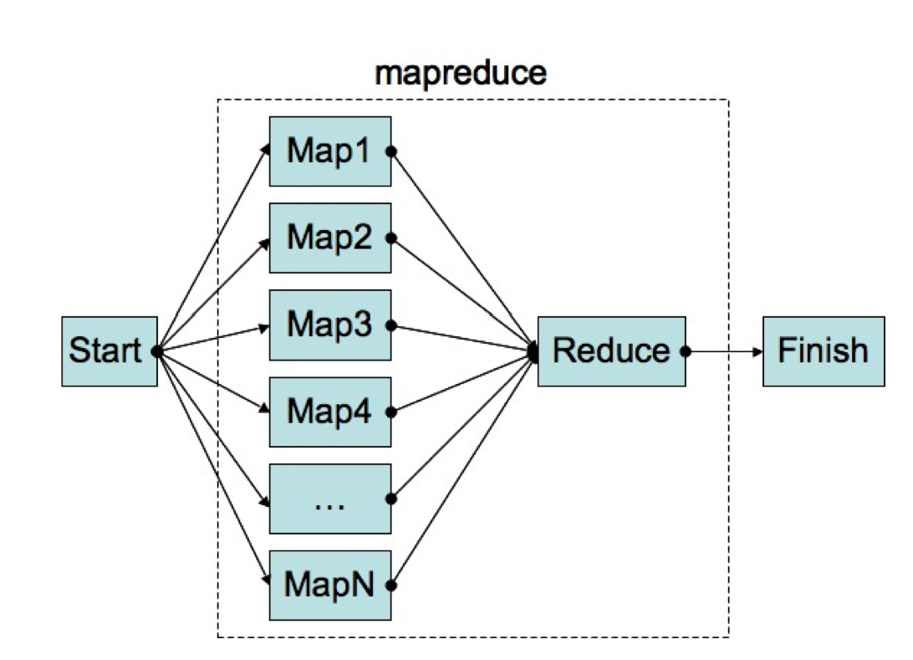
Problem #3: Processing distributed across multiple nodes

Slide 14
How are you currently preventing BUGS?

Slide 15

Consequences
The Longer you wait to find and fix a problem the more time it will take to fix it!

Slide 16

Verify “DONE”

Slide 17
What 4 things do we need to Verify?

Slide 18
Does it run?

Slide 19
2.) Functional Correctness to Requirements
Data Filters
Loops and branches
Calculations
Output

Slide 20
3. Resources Correctly Referenced
Missing files
Bad file names
Etc.

Slide 21
4. Exceptions and errors properly handled
System left in a safe state
User / SysAdmin informed of the failure
Idempotency

Slide 22
Materiality Rule
Materiality Rule: Start with High value tests (easy to test AND valued by business)
Light & Fast : Don’t create an overly heavy test process
Positive Tests:
Tests should contain one general data condition
Individual tests only for those determined by specific data conditions
Negative Tests:
Data not present

Slide 24
Traditional Sampling Problems
Sample error reflects the risk that, purely by chance, a randomly chosen sample of opinions does not reflect the true views of the population. The “margin of error” reported in opinion polls reflects this risk and the larger the sample, the smaller the margin of error
sampling bias is a bias in which a sample is collected in such a way that some members of the intended population are less likely to be included than others. (wikipedia)
Notes:
Define standard sample problems…then transition to our relevant sample errors

Slide 25
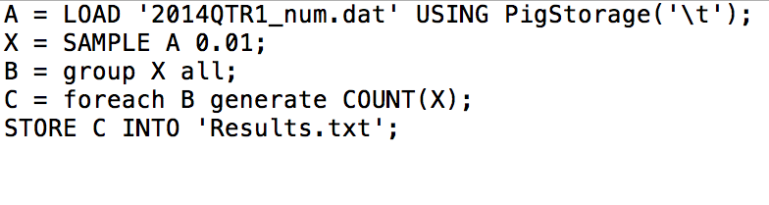
PIG SAMPLE
Notes:
Random dataset…Only parameter is % of the dataset
Testing though sometime needs to reference the data datasets!

Slide 26
Manual Sampling
Build the sample dataset based on your program’s logic.
Does not need to be more than a few rows for each test.
Can get embedded within your test program to facilitate test management.

Slide 27

MapReduce testing framework
Accepts a small record sample for each test
Test one thing per test
Does not reference HDFS directly
Tests Map and Reduce methods separetly

Slide 28
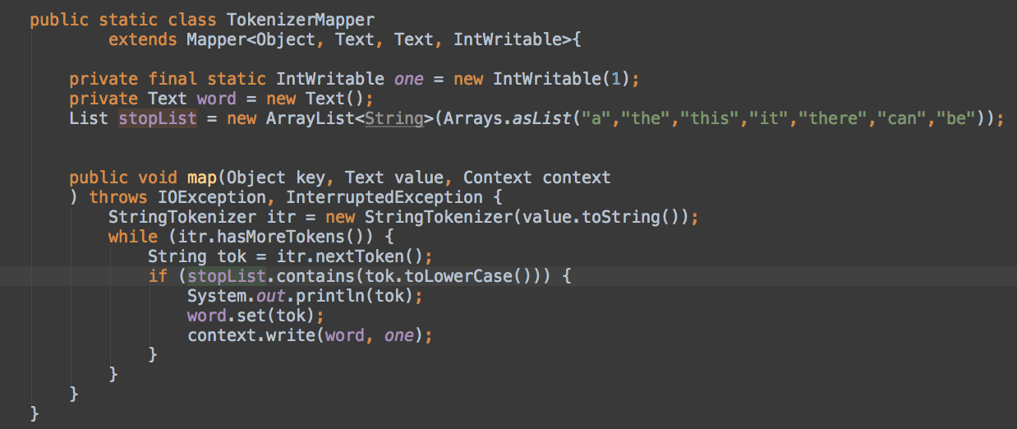
Example: Word Count Program - Mapper
Does the tokenize work properly
Does the Mapper properly filter ‘stop’ words
Is the counter properly initialized

Slide 29
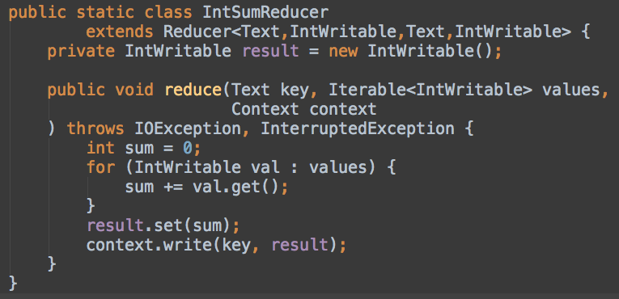
Example: Word Count - Reducer
Keys counter values grouped properly
Counter values are properly aggregated

Slide 30
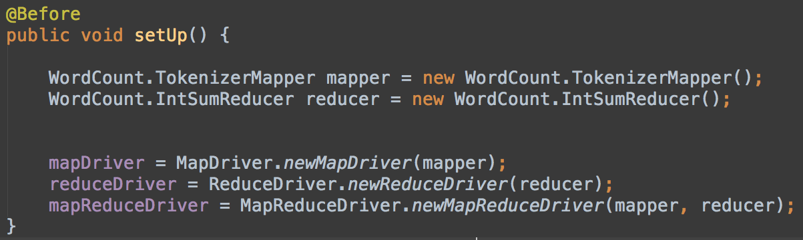
Setup MRUnit test suite
MapDriver:
ReduceDriver:
MapReduceDriver:

Slide 31
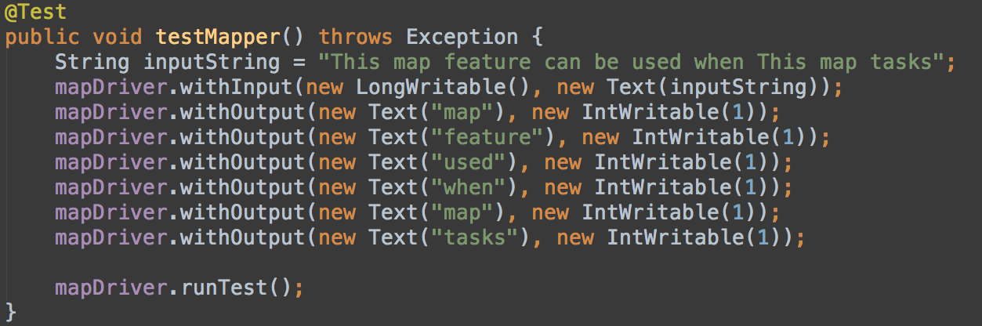
MRUnit Mapper test

Slide 32
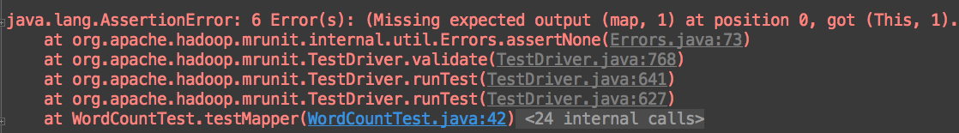
Test Results

Slide 33
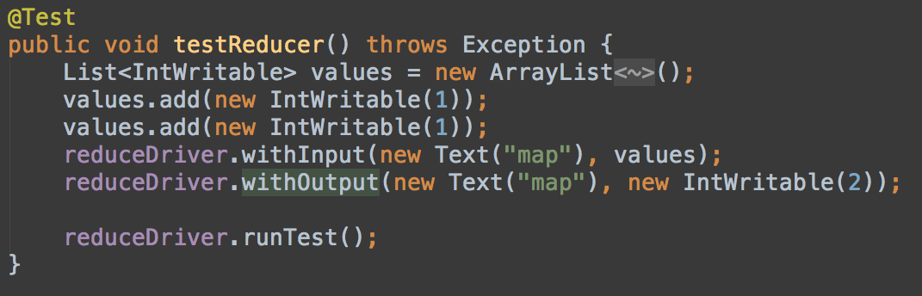
MRUnit Reducer Test

Slide 34
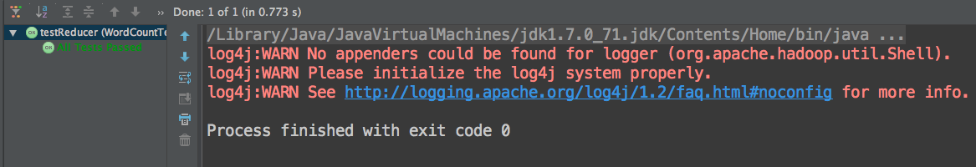
Test Results

Slide 35

Traditional Pig Functional Testing tools
DUMP
ILLUSTRATE
DESCRIBE
EXPLAIN

Slide 36
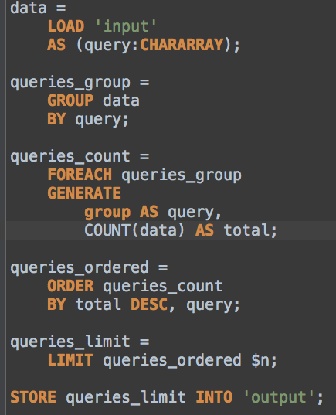
PigUnit to test Pig scripts
Only one LOAD operation per test script.
PigUnit overrides STORE, LOAD and DUMP

Slide 37
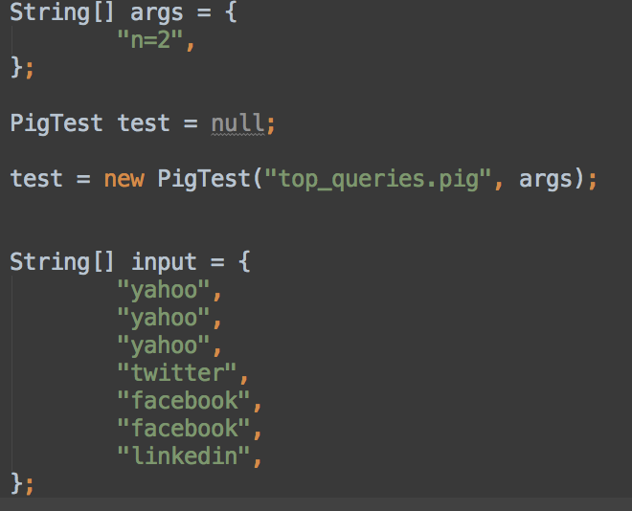
PigUnit – Setup
PigTest references your unmodified pig script for testing.
Input:
Include just the rows required to test logic

Slide 38
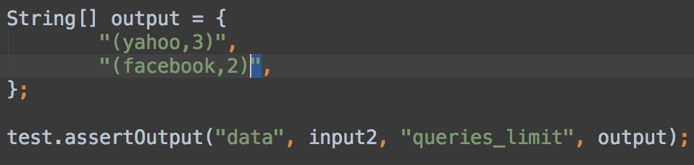
PigUnit: Assert

Slide 39
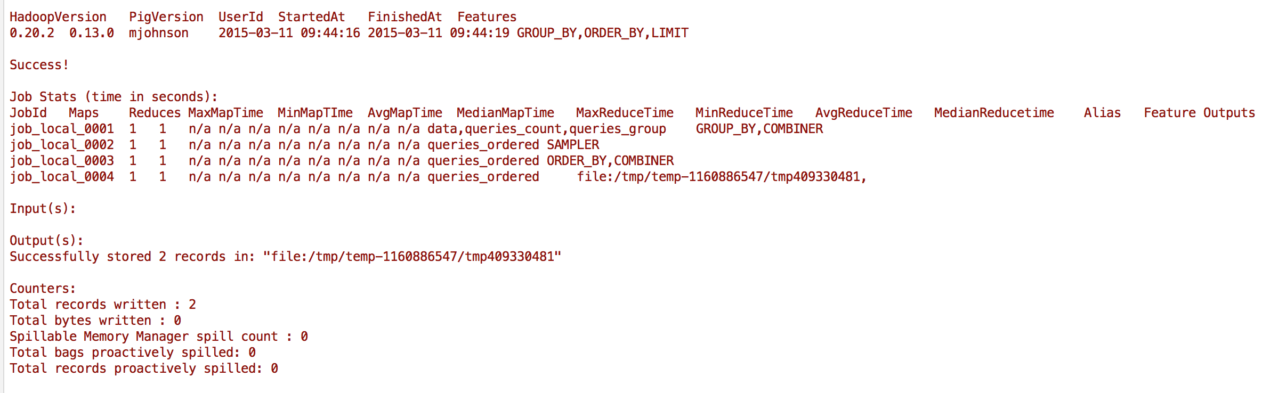

Slide 40
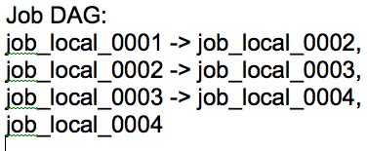
PigUnit: Output Job Order

Slide 41
BeeTest
Developed by: Adam Kawa
GitHub Project: https://github.com/kawaa/Beetest.git
Beetest provides a simple ‘unit’ test capability on a given Hadoop Hive script which runs on a small cluster to validate a Hive script

Slide 42
Beetest: Inputs and Outputs
Directory containing the following files defining the test process:
setup.hql – The HQL script to setup the environment
select.hql – The HQL script to test
Input.tsv – input data
Expected.txt – the script’s expected output
variables.properties – the Beetest properties

Slide 43
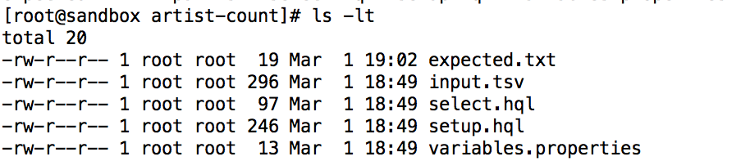
Setting up BeeTest

Slide 44
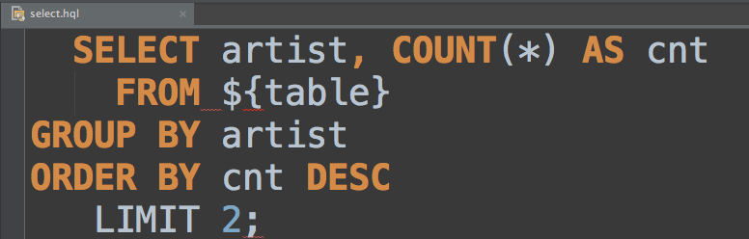
BeeTest: Executing the test
${table} – value defined in variables.properties

Slide 45
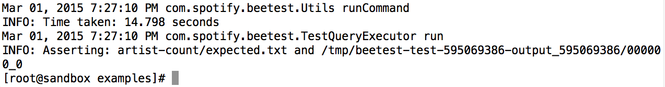
BeeTest – Test Results

Slide 46
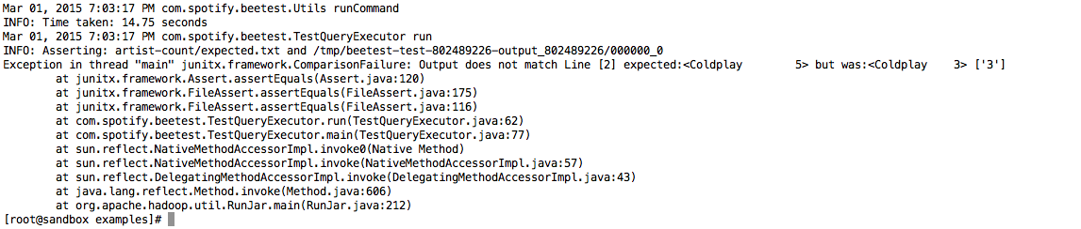
BeeTest: Test failures

Slide 47
Getting started with your test initiative
Start Simple
Materiality rule: Focus on Highest value and easiest tests first
Data Sampling: Use the smallest datasets possible
Keep tests “light and fast”
Keep Hadoop code and tests in a Source Code Management system
Use Automated test environment (Jenkins, AntHill Pro, etc.)
Maintain and publicly publish historical test results

Slide 48
Hadoop Test Tool Wrap Up
Tools and Techniques
Data Sampling
MRUnit
PigUnit
Beetest
Testing environment still imature but good enough to start using now

Slide 49
Mark Johnson Regional Director Services Hortonworks markfjohnson@gmail.com mjohnson@hortonworks.com Linkedin:markfjohnson Twitter: markfjohnson Source: https://github.com/mfjohnson/HadoopTesting.git

